Slide 1
Mastering Supervised Learning: Concepts, Algorithms, and Applications

Slide 2
Learning Objectives
By the end of this session, you will be able to:
• Understand the fundamental concepts of supervised learning.
• Explore the different types of supervised learning algorithms and their applications.
• Differentiate between classification and regression tasks in supervised learning.
• Identify key factors for selecting appropriate supervised learning algorithms.
• Gain insights into the strengths and weaknesses of various supervised learning algorithms.

Slide 3
Introduction to Supervised Learning
• Supervised learning is a core concept in machine learning, a subfield of Artificial Intelligence.
• Models learn from labeled data, which includes both inputs and their corresponding target outputs.
• It establishes a clear, explicit relationship between input data and the desired outcome.
• The primary goal is to enable the model to make predictions or decisions on new, unseen data.
• The fundamental idea is to teach the model to effectively map inputs to correct outputs.

Slide 4
Core Concepts
• The learning process begins by providing the algorithm with a training dataset.
• This dataset comprises numerous input-output pairs, allowing the model to learn from examples.
• The model analyzes this data to identify inherent patterns and relationships.
• These learned patterns are then used to generalize and predict outcomes for new inputs.
• Supervised learning forms the building blocks for many advanced AI applications requiring predictive capabilities.

Slide 5
Classification
• Classification is a supervised learning task focused on assigning inputs to predefined categories.
• The output variable in classification is typically categorical (e.g., "spam" or "not spam").
• The model learns to draw decision boundaries in the input space to distinguish between classes.
• Common examples include spam email detection, image categorization, and sentiment analysis.
• Key algorithms for classification include Decision Trees, Support Vector Machines (SVM), and Neural Networks.

Slide 6
Regression
• Regression is a supervised learning task aimed at predicting a continuous, numerical output value.
• The model learns to approximate a function that maps inputs to real numbers.
• The objective is to find the best-fitting curve or hyperplane that minimizes error between predicted and actual values.
• Common examples include predicting house prices, forecasting stock values, and estimating age from data.
• Key algorithms for regression include
Linear Regression,
Random Forest Regression, and
Gradient Boosting Regression.

Slide 7
Key Algorithms: Part 1
• Linear Regression: A foundational regression algorithm assuming a linear relationship between input features and the target. It seeks to find a straight line that best minimizes the sum of squared errors.
• Decision Trees: Versatile algorithms used for both classification and regression. They recursively split data based on significant features, forming a tree-like structure.
• Decision Trees are highly interpretable, making their decision-making process easy to understand.
• They can efficiently handle both numerical and categorical data types.
• These algorithms provide fundamental approaches to predictive modeling.

Slide 8
Key Algorithms: Part 2
• Support Vector Machines (SVM): Primarily a classification algorithm that identifies an optimal hyperplane to separate data into distinct classes.
• SVMs are effective for both linearly and non-linearly separable data through the use of various kernel functions.
• Neural Networks: Consist of layers of interconnected neurons, capable of approximating complex non-linear relationships.
• Deep learning, a subset of neural networks, has driven significant advancements in fields like image recognition and natural language processing.
• While powerful, neural networks often require substantial computational resources for training.

Slide 9
Key Algorithms: Part 3
• Random Forest: An ensemble learning algorithm that enhances prediction accuracy by combining multiple decision trees.
• It is known for its robustness and capability to handle high-dimensional datasets with many features.
• k-Nearest Neighbors (KNN): A simple, effective classification algorithm that classifies data points based on the majority class among their 'k' nearest neighbors.
• KNN's performance is critically dependent on the chosen distance metric and the specific value of 'k'.
• Both algorithms offer unique approaches to tackling supervised learning challenges with varying complexities.

Slide 10
Key Algorithms: Part 4
• Naive Bayes: A probabilistic classification algorithm founded on Bayes' theorem.
• It operates under the assumption of strong independence among features, simplifying calculations.
• Naive Bayes is particularly well-suited for various text classification applications.
• Common uses include effective spam detection and sentiment analysis.
• Its simplicity and efficiency make it a valuable tool, even with limited training data.

Slide 11
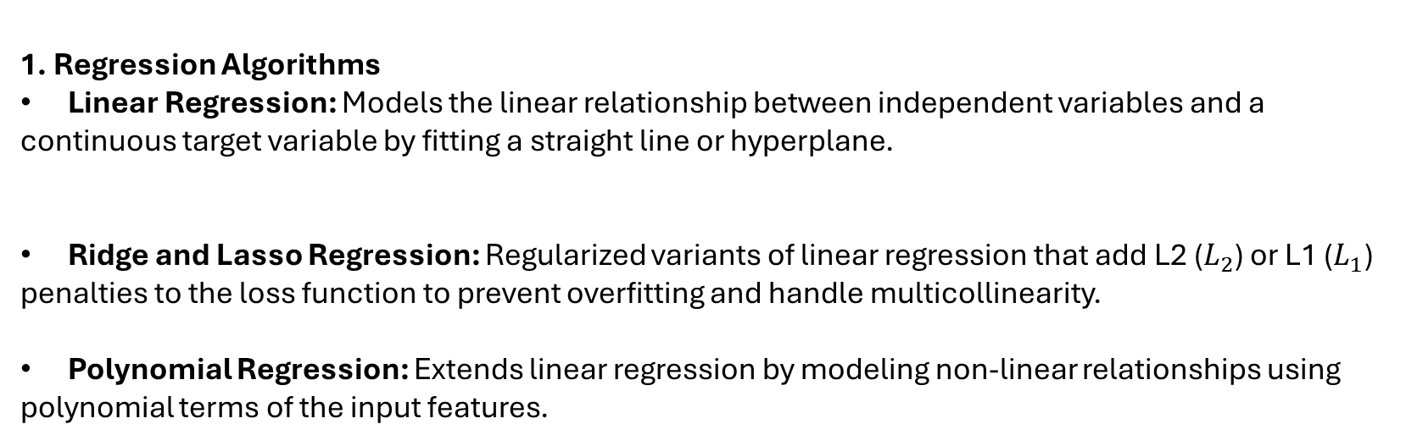
1. Regression Algorithms
Linear Regression: Models the linear relationship between independent variables and a continuous target variable by fitting a straight line or hyperplane.
Ridge and Lasso Regression: Regularized variants of linear regression that add L2 ($L_{2}$) or L1 ($L_{1}$) penalties to the loss function to prevent overfitting and handle multicollinearity.
Polynomial Regression: Extends linear regression by modeling non-linear relationships using polynomial terms of the input features.

Slide 12
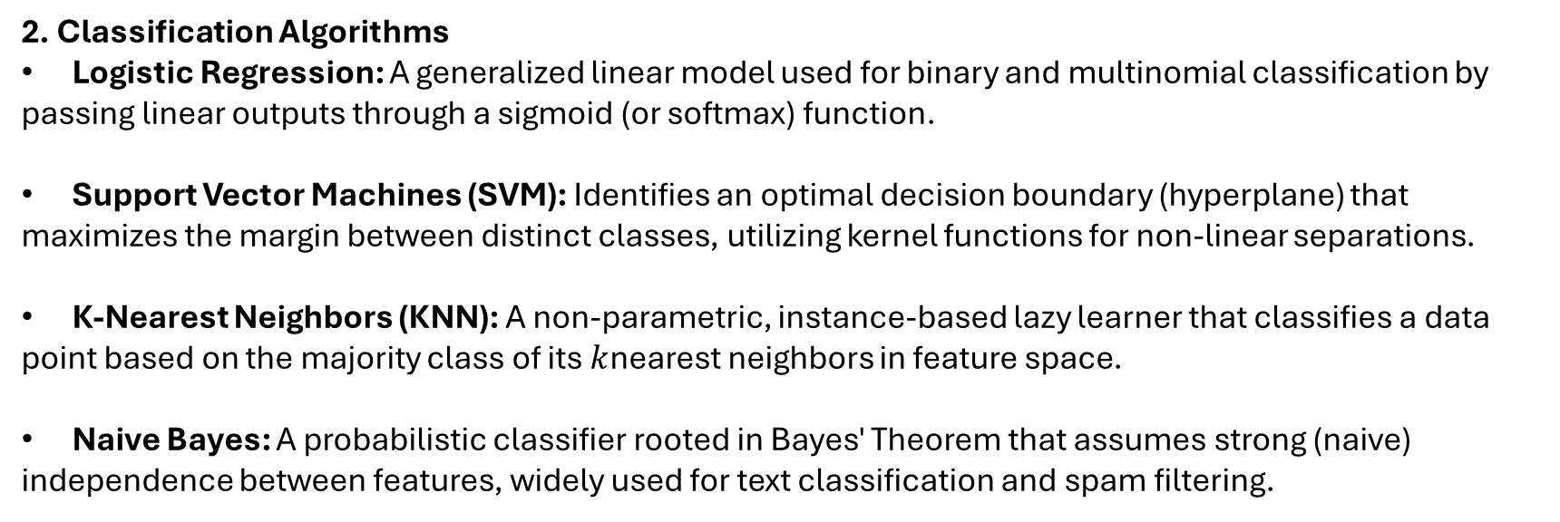
2. Classification Algorithms
Logistic Regression: A generalized linear model used for binary and multinomial classification by passing linear outputs through a sigmoid (or softmax) function.
Support Vector Machines (SVM): Identifies an optimal decision boundary (hyperplane) that maximizes the margin between distinct classes, utilizing kernel functions for non-linear separations.
K-Nearest Neighbors (KNN): A non-parametric, instance-based lazy learner that classifies a data point based on the majority class of its $k$nearest neighbors in feature space.
Naive Bayes: A probabilistic classifier rooted in Bayes' Theorem that assumes strong (naive) independence between features, widely used for text classification and spam filtering.

Slide 13
3. Tree-Based & Ensemble Algorithms
Decision Trees: Splits data recursively based on feature thresholds to construct a flowchart-like hierarchical tree of decisions.
Random Forest: A bagging ensemble method that trains multiple decision trees in parallel on bootstrapped subsets of data and features, reducing variance and preventing overfitting.
Gradient Boosting (XGBoost, LightGBM, CatBoost): Boosting ensemble techniques that build trees sequentially, where each new tree specifically targets and corrects the residual errors of the previous ensemble.
4. Neural Networks & Deep Learning
Multilayer Perceptrons (MLP): Feedforward artificial neural networks consisting of input, hidden, and output layers capable of learning complex, non-linear feature representations via backpropagation.

Slide 14
Choosing the Right Algorithm: Factors
• Model Performance: The primary factor, evaluated using metrics such as
accuracy,
precision,
recall (for classification), or
mean squared error (for regression).
• Data Characteristics: The nature of the data, including its size, dimensionality, and distribution, significantly influences algorithm suitability.
• Some algorithms perform better on high-dimensional data, while others are more suitable for smaller datasets.
• Thorough understanding of the dataset is crucial for making an informed choice.
• There is no single "best" algorithm; the ideal choice is problem- and data-dependent.

Slide 15
Choosing the Right Algorithm: Considerations
• Computational Resources: Availability of CPU, GPU, and memory can restrict algorithm selection, as some models (e.g., deep learning) are computationally intensive.
• Interpretability: For applications requiring transparency, algorithms that offer understandable decision-making processes (e.g., Decision Trees, Linear Regression) are preferred.
• Robustness: This refers to an algorithm's ability to maintain performance in the presence of noisy or missing data. Random Forest and SVM are noted for their robustness.
• Balancing these factors leads to effective, practical, and justifiable machine learning solutions.
• Careful consideration across these dimensions is key to successful model deployment.

Slide 16
Academic Poll
Question 1: Which of the following best describes the fundamental characteristic of data used in supervised learning?
A) Data consists of features with no predefined categories.
B) Data includes only numerical values without associated labels.
C) Data is labeled, meaning each input is paired with a known target output.
D) Data is collected through real-time interaction with an environment.

Slide 17
Academic Poll
Question 1: Which of the following best describes the fundamental characteristic of data used in supervised learning?
A) Data consists of features with no predefined categories.
B) Data includes only numerical values without associated labels.
C) Data is labeled, meaning each input is paired with a known target output.
D) Data is collected through real-time interaction with an environment.
Correct Answer: C) Data is labeled, meaning each input is paired with a known target output.
Explanation: Supervised learning explicitly requires labeled data, where the correct output for each input is known, allowing the model to learn the mapping function. Options A, B, and D describe characteristics of unsupervised or reinforcement learning, or incomplete descriptions.

Slide 18
Academic Poll
Question 2: A financial institution wants to develop a model to predict the credit score (a numerical value between 300 and 850) of loan applicants based on their financial history. What type of supervised learning task is this, and which algorithm could be a suitable initial choice?
A) Classification; Decision Tree
B) Regression; Linear Regression
C) Classification; Support Vector Machine
D) Regression; k-Nearest Neighbors (KNN)

Slide 19
Academic Poll
Question 2: A financial institution wants to develop a model to predict the credit score (a numerical value between 300 and 850) of loan applicants based on their financial history. What type of supervised learning task is this, and which algorithm could be a suitable initial choice?
A) Classification; Decision Tree
B) Regression; Linear Regression
C) Classification; Support Vector Machine
D) Regression; k-Nearest Neighbors (KNN)
Correct Answer: B) Regression; Linear Regression
Explanation: Predicting a credit score, which is a continuous numerical value, is a regression task. Linear Regression is a fundamental algorithm for such tasks, assuming a linear relationship between input features and the target. Decision Trees and SVM are primarily associated with classification, and while KNN can do regression, Linear Regression is a more direct fit for predicting a continuous score.

Slide 20
Academic Poll
Question 3: In the context of evaluating supervised learning algorithms, if a model's decision-making process needs to be clearly understood and explained to stakeholders (e.g., in medical diagnosis), which factor would be prioritized?
A) Computational Resources
B) Robustness
C) Interpretability
D) Data Characteristics

Slide 21
Academic Poll
Question 3: In the context of evaluating supervised learning algorithms, if a model's decision-making process needs to be clearly understood and explained to stakeholders (e.g., in medical diagnosis), which factor would be prioritized?
A) Computational Resources
B) Robustness
C) Interpretability
D) Data Characteristics
Correct Answer: C) Interpretability
Explanation: Interpretability refers to how transparent and understandable a model's decision-making process is. In fields like medical diagnosis or finance, being able to explain why a specific prediction was made is crucial, making interpretability a top priority. The other factors are important but do not directly address the need for understanding the "why" behind predictions.

Slide 22
Academic Poll
Question 4: A supervised learning model is being developed to distinguish between benign and malignant tumors based on patient data. This involves assigning each case to one of two distinct categories. Which of the following algorithms is not typically used for such a classification task?
A) Decision Trees
B) Support Vector Machines (SVM)
C) Linear Regression
D) Neural Networks

Slide 23
Academic Poll
Question 4: A supervised learning model is being developed to distinguish between benign and malignant tumors based on patient data. This involves assigning each case to one of two distinct categories. Which of the following algorithms is not typically used for such a classification task?
A) Decision Trees
B) Support Vector Machines (SVM)
C) Linear Regression
D) Neural Networks
Correct Answer: C) Linear Regression
Explanation: Linear Regression is a regression algorithm designed to predict continuous numerical values. Classification tasks, like distinguishing between benign and malignant tumors, require algorithms that predict categorical outcomes. Decision Trees, SVM, and Neural Networks are all common algorithms used for classification.

Slide 24
Academic Poll
Question 5: A company is building a spam email detector. They have a dataset of millions of emails, many of which are unlabeled, but a smaller subset has been manually labeled as 'spam' or 'not spam'. If the goal is to make use of both labeled and unlabeled data for training, which learning paradigm would involve combining supervised and unsupervised elements, but is not the focus of section 2.1?
A) Supervised Learning
B) Unsupervised Learning
C) Reinforcement Learning
D) Semi-Supervised Learning

Slide 25
Academic Poll
Question 5: A company is building a spam email detector. They have a dataset of millions of emails, many of which are unlabeled, but a smaller subset has been manually labeled as 'spam' or 'not spam'. If the goal is to make use of both labeled and unlabeled data for training, which learning paradigm would involve combining supervised and unsupervised elements, but is not the focus of section 2.1?
A) Supervised Learning
B) Unsupervised Learning
C) Reinforcement Learning
D) Semi-Supervised Learning
Correct Answer: D) Semi-Supervised Learning
Explanation: While section 2.1 focuses only on Supervised Learning, the question asks about a paradigm that combines labeled and unlabeled data, making Semi-Supervised Learning the correct answer. Standard Supervised Learning relies solely on labeled data, Unsupervised Learning on unlabeled data, and Reinforcement Learning is a different paradigm altogether.

Slide 26
Academic Poll
Question 6: When selecting a supervised learning algorithm, considering whether it performs well in the presence of missing or incorrect input values relates to which factor?
A) Model Performance
B) Interpretability
C) Robustness
D) Computational Resources

Slide 27
Academic Poll
Question 6: When selecting a supervised learning algorithm, considering whether it performs well in the presence of missing or incorrect input values relates to which factor?
A) Model Performance
B) Interpretability
C) Robustness
D) Computational Resources
Correct Answer: C) Robustness
Explanation: Robustness refers to how well an algorithm maintains its performance and accuracy when dealing with imperfections in the data, such as noise or missing values. Algorithms known for good robustness can handle such issues better, making them more reliable in real-world scenarios.

Slide 28
Academic Poll
Question 7: A data scientist is working on a project to automatically classify news articles into predefined topics (e.g., 'Politics', 'Sports', 'Technology'). They have a large dataset of articles, each with a known topic label. Which supervised learning task and a commonly associated algorithm would be most appropriate for this problem?
A) Regression; Random Forest Regression
B) Classification; Naive Bayes
C) Clustering; K-Means
D) Dimensionality Reduction; PCA

Slide 29
Academic Poll
Question 7: A data scientist is working on a project to automatically classify news articles into predefined topics (e.g., 'Politics', 'Sports', 'Technology'). They have a large dataset of articles, each with a known topic label. Which supervised learning task and a commonly associated algorithm would be most appropriate for this problem?
A) Regression; Random Forest Regression
B) Classification; Naive Bayes
C) Clustering; K-Means
D) Dimensionality Reduction; PCA
Correct Answer: B) Classification; Naive Bayes
Explanation: Classifying news articles into predefined topics is a classification task, as the output is a categorical label. Naive Bayes is explicitly mentioned as being particularly suitable for text classification tasks, such as sentiment analysis and spam detection, which are similar in nature to topic classification for news articles. Regression, Clustering, and Dimensionality Reduction are different types of tasks.

Slide 30
Case Study / Business Application
A new e-commerce startup, "TrendFinds," wants to personalize the user experience on its website. Specifically, they have two immediate goals:
1. Product Recommendation: When a user visits a product page, TrendFinds wants to suggest a price range for similar, complementary items based on the current product's features (e.g., if a user views a high-end dress, suggest shoes in a matching premium price range).
2. Product Categorization: When new products are added to their inventory, the system needs to automatically assign them to one of their existing main product categories (e.g., "Apparel," "Electronics," "Home Goods," "Beauty"). They have a large historical dataset of products with their correct categories.
Identify the appropriate supervised learning task for each of TrendFinds' goals and suggest one suitable algorithm for each task, briefly justifying your choices based on the principles of supervised learning.

Slide 31
Case Study / Business Application
Solution:
Goal 1: Product Recommendation (Price Range Suggestion)
Supervised Learning Task: Regression
Justification: The task involves predicting a "price range," which signifies a continuous numerical output (or a range defined by continuous numbers). Regression models are specifically designed to forecast such continuous values.
Suitable Algorithm: Linear Regression or Random Forest Regression.
Linear Regression: A suitable initial choice if the relationship between product features and price is assumed to be roughly linear, offering simplicity and interpretability.
Random Forest Regression: A more robust option if the relationship is complex and non-linear, as it leverages an ensemble of decision trees to capture intricate patterns and is less prone to overfitting than a single tree.
Goal 2: Product Categorization
Supervised Learning Task: Classification
Justification: This goal requires assigning new products to one of several predefined, distinct categories ("Apparel," "Electronics," etc.). This is a classic classification problem where the model learns to predict a categorical label. The availability of a large historical dataset with correct categories makes supervised classification the ideal approach.
Suitable Algorithm: Decision Trees or Support Vector Machines (SVM).
Decision Trees: They are highly interpretable and can effectively handle various product features (both numerical and categorical). They create clear rules for categorization.
Support Vector Machines (SVM): Excellent for distinguishing between different product categories, especially when the data might have complex, non-linear boundaries between categories through the use of kernel functions.

Slide 32
Session Summary
• Understanding the fundamental concepts of supervised learning.
• Exploration of the different types of supervised learning algorithms and their applications.
• Differentiating between classification and regression tasks in supervised learning.
• Identification of key factors for selecting appropriate supervised learning algorithms.
• Gaining insights into the strengths and weaknesses of various supervised learning algorithms.

